Slide 1

Новинки CatBoost: поддержка эмбеддингов, Spark и предсказание неопределенности
Кириллов Станислав, Руководитель группы ML систем @ Яндекс
Notes:
Hello! My name is XXX and i am YYY at Yandex. Yandex is a big Russian internet company, that has different services, such as Internet search engine, Taxi service, Food delivery, Self driving cars, media streaming and many other.
And today I want to talk about a GBDT library CatBoost – wich is widely used in Yandex and in many other companies. I hope CatBoost can be useful for you.

Slide 2
Plan
Вступление
Поддержка текстов и эмбеддингов
SPARK и распределенное обучение
Предсказание неопределенности
Новости и планы
Notes:
I’ll start my talk with Gradient boosting overview, than we will discuss CatBoost library, then we will study some CatBoost usecases.
After that I will talk about CatBoost superpowers – cuda training speed, distributed training and different feature types support.
In the last part I’ll talk about big data training support.

Slide 3

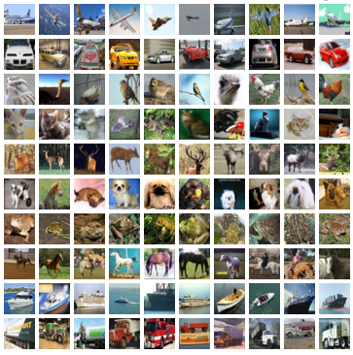
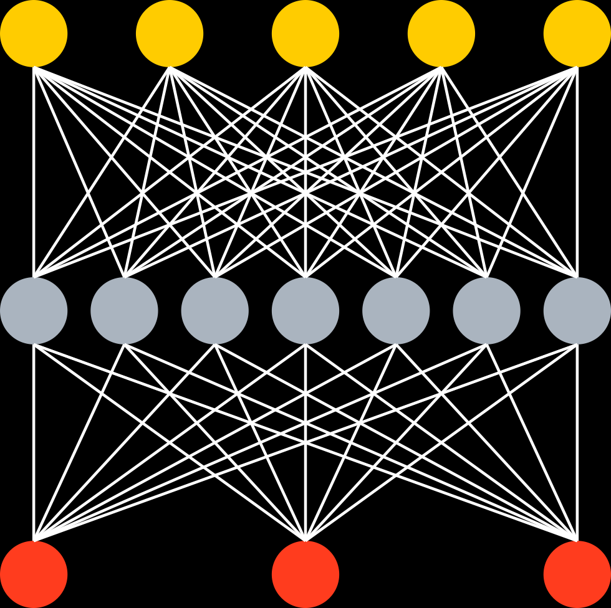
Ваши данные
Неструктурированные
Табличные (структурированные)
^{Music track length} | ^{Year} | ^{Rating} | ^{Label}
² | ¹⁹⁹⁰ | ³ | ¹
³ | ¹⁹⁵⁰ | ⁵ | ⁰
¹⁵ | ¹⁹⁷⁰ | ⁴ | ¹
Звук
ДНК
Изображения
Тексты
End2End DNN
GBDT
+
+
+
+
…
Big error
Better
Ship it
Notes:
Here you can seen one way to classify type of data used to solve practical problems today
Firstly, we have so-called unstructured data, like images, where deep learning techniques shows the great result
Secondly, we have tabular, or structured data: well-engineered features are used to describe sample we use to make predictions.Each sample is just a row of float numbers in table. Plus a label that we need to predict.
For this type of data the state-of-the-art results are achieve by GBDT

Slide 4






Пользователи CatBoost
Recommendations at Netflix
Hotel ranking in Aviasales
Protection against bots in CloudFlare
Particle classification in CERN
Medical research at University of NSW Sydney
Destination prediction in Careem taxi service
ML competitions on Kaggle

Slide 5
Тексты и эмбеддинги

Slide 6
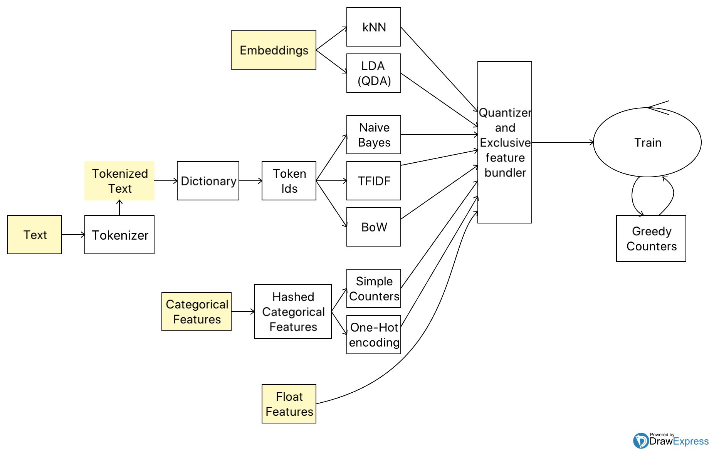
CatBoost – это интересно!
Notes:
now let's look at a more complicated case when the object has some linked unstructured data – like image, video, or text. To work with this data you can build a vector representation of this data, called object embedding and pass it to CatBoost. Embedding could be a prediction of some model, for example some neural network. For example, there are some well known models that allow you to compute embeddings for texts – it is classical word2vec models , bert and gpt models.
Someone can try feeding those vectors to gradient boosting algorithm as is, and it could somehow work, but training on 736 dimensional vectors that may have rather strange distribution in ndimensional space is a hard task for gbdt.
As our experiments and practical experience summary says, it’s better to somehow reduce dimensionality of embedding vectors to help GBDT make proper splits.

Slide 7

Текстовые фичи
BM25
at first i was afraid i was petrified kept thinkin i could never live without you by my side
[0, 1, 2, 3, 4, 2, 3, 5, 6, 7, 2, 8, 9, 10, 11, 12, 13, 14, 15]
Naïve Bayes
Bag-of-Words
Dictionary
Notes:
When CatBoost have built all the needed dictionaries sequence tokens are converted to sequence of token ids, which is shown on current slide.
Sequences of token ids are then processed with 3 different feature estimators.
The trivial one is Bag of word feature estimator that just creates a binary vector representation of presence of given token id in some object.
Naïve Bayes is a feature estimator that tries to estimate probability of belonging to a class.
Another Feature estimator is a classic BM25, or TFIDF. We use a corpus of all tokens statistics for each class to calculate this metric.

Slide 8
Bag of Words
По умолчанию: словные униграммы + биграммы
Для каждого токена из набора (словаря) проверяем, есть ли этот токен в тексте, кодируем как 0 и 1
Dictionary 1:
yesterday, petrified
Dictionary 2:
at+first, i+has, could+never, …
at first i was afraid i was petrified kept thinkin i could never live without you by my side
Feature values:
0,1,1,0,1
Notes:
Now let me show examples of those estimators. The simplies text feature estimator is Bag of words. On this slide you can see an example of applying two different dictionaries – first is a single word dictionary, the other one is bigram dictionary. After applying them to text and setting vector values with indices of tokens that were in text to 1 we have bag of words representation of text.

Slide 9
Naïve Bayes
Для каждого класса хотим оценить вероятность P(Class|Text)
P(Class|Text) заменяем на произведение P(Class) * Пi P(wordi | Class)
Самое важное: считаем “online”
Notes:
Naïve Bayes generates a new feature column for each class label.
The value of estimated feature for some class is a product of class probability and product of conditional probability for each token met in current text
When calculating this kind of feature estimator it’s critical to avoid target leakage, so we apply our online technique here.

Slide 10
BM-25 for MultiClass
Новая вещественная фича для каждого класса
TF – частота токена в тексте
IDF – обратная частота слова в “документе”, здесь
“документ” – это конкатенация всех текстов данного класса
Самое важное: считаем “online”
Notes:
Another important feature estimator is BM25. Again, BM25 generates a new feature column for each class label.
The value of estimated feature for some class is a sum of product of inverted document frequency for token in virtual document that is a concatenation of concatenation of all texts in this class and term frequency in current text
Like in Naïve bayes, it’s critical to avoid target leakage, so we apply our online technique also in that estimator.

Slide 11
Что значит считать «онлайн»?
Для каждого объекта в данной перестановке мы считаем значения используя только информацию об объектах, которые стоят в перестановке раньше текущего объекта
SDE
1
SDE
1
SDE
0
PR
i
SDE
1
PR
1 + 1 + 0
i
3
Notes:
When you are calculating cat feature statistics it’s critically important to avoid target leakage – it would lead to overfitting on training data. In CatBoost we use technique named online feature estimation – we determine 3 different random orders of objects and then we are using statistics for objects that were before current object in a permutation as a value on current object. We update category statistics with the target value of current object and got to next object

Slide 12
Эмбеддинги объектов
🐶
{x₁, x₂, x₃,…., x_{N}}
Широко известные эмбеддинги: EfficientNet, Word2Vec, Transformers(Bert, GPT, etc)
Notes:
now let's look at a more complicated case when the object has some linked unstructured data – like image, video, or text. To work with this data you can build a vector representation of this data, called object embedding and pass it to CatBoost. Embedding could be a prediction of some model, for example some neural network. For example, there are some well known models that allow you to compute embeddings for texts – it is classical word2vec models , bert and gpt models.
Someone can try feeding those vectors to gradient boosting algorithm as is, and it could somehow work, but training on 736 dimensional vectors that may have rather strange distribution in ndimensional space is a hard task for gbdt.
As our experiments and practical experience summary says, it’s better to somehow reduce dimensionality of embedding vectors to help GBDT make proper splits.

Slide 13
Эмбеддинги объектов: что мы пробовали
Cosine дистанции до центров кластеров
Линейные модели
FTRL
✅ kNN
✅ LDA и QDA
На самом деле, все эти методы работают довольно неплохо, на разных датасетах они работают очень по разному, но по нашим экспериментам два кандидата – kNN и LDA показали лучший результат.
Notes:
now let's look at a more complicated case when the object has some linked unstructured data – like image, video, or text. To work with this data you can build a vector representation of this data, called object embedding and pass it to CatBoost. Embedding could be a prediction of some model, for example some neural network. For example, there are some well known models that allow you to compute embeddings for texts – it is classical word2vec models , bert and gpt models.
Someone can try feeding those vectors to gradient boosting algorithm as is, and it could somehow work, but training on 736 dimensional vectors that may have rather strange distribution in ndimensional space is a hard task for gbdt.
As our experiments and practical experience summary says, it’s better to somehow reduce dimensionality of embedding vectors to help GBDT make proper splits.

Slide 14
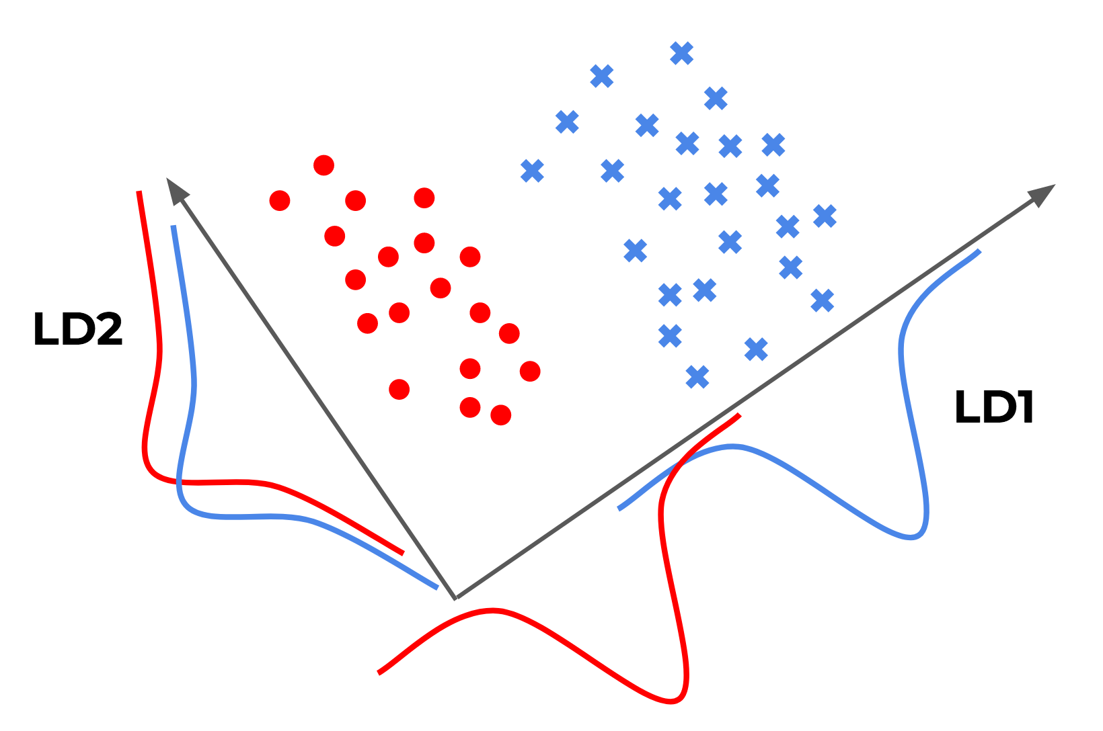
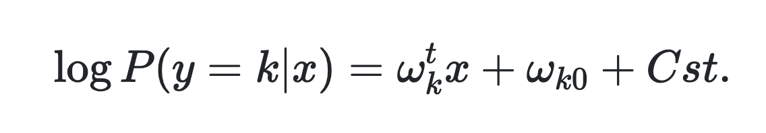
Линейный дискриминантный анализ
Ищет такие проекции, которые
разделяют объекты разных классов
Исходим из предположения о нормальном распределении компонентов эмбеддингов
Важно: используем ту же идею онлайн обучения
https://raw.githubusercontent.com/eigenfoo/eigenfoo.xyz/master/assets/images/lda-pic.png
Notes:
One classical method of dimensionality reduction is making some projections to lower-dimensional subspace. We were trying different kinds of projections and, surprisingly, one of the simplest classical methods worked really good.
I am speaking about linear discriminant analysis.
It is an algorithm that tries to find a linear projections that maximally separate objects of different classes. On this slide there is a simple illustration of two different one dimensional projections - first one, LD1 is a good projection as it properly separates blue crosses from red dots. And LD2 projection provides poor objects separation
And, of course, even that estimator is trained in online setting.

Slide 15
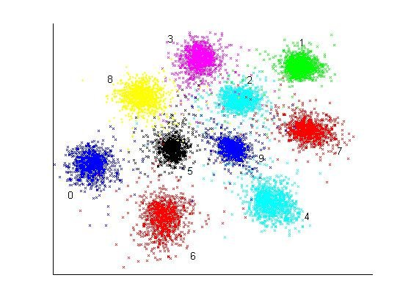
kNN
Онлайн подсчет:
For each object in permutation:
Query k-nearest neighbours
Get classes for found neighbours
Treat class-frequencies as features for CatBoost
Update HNSW index
A Deep Non-Linear Feature Mapping for Large-Margin kNN Classification - Scientific Figure on ResearchGate.
Available from: https://www.researchgate.net/figure/Two-dimensional-embedding-of-10-000-MNIST-test-data-using-the-Deep-Neural-Network-kNN_fig9_22076648
Notes:
Another emeddings feature estimator that gives quality boost on top of linear discriminant analysis – k nearest neighbors search. For each object we can query k closest training examples in the embedding vectors space.
The proportion of classes in set of k objects neighbors is a ready to use feature for gbdt
We use our own implementation of Hierarchical Navigable Small World and, of course, we are building that index iteratively in online manner to avoid target leakage.

Slide 16
Как попробовать эмбеддинги в CatBoost?
train_pool_embeddings = Pool(
X_train_with_embeds, y_train,
cat_features=cat_features,
text_features=['synopsis', 'genre', 'director', 'writer', 'review’],
embedding_features=['synopsis_embeds', 'review_embeds']
)
test_pool_with_embeddings = Pool(
X_test_with_embeds, y_test,
cat_features=cat_features,
text_features=['synopsis', 'genre', 'director', 'writer', 'review’],
embedding_features=['synopsis_embeds', 'review_embeds']
)
model = catboost.CatBoostClassifier(task_type='GPU') model.fit(train_pool_embeddings, test_pool_with_embeddings)
Notes:
And on this slide you can see practically all the code you need to write to start training on embeddings and texts in Python.
Creating Pool object is not necessary action, but if you are planning to tune parameters, it’s better to use Pool object to avoid overhead of copying data form python to c++

Slide 17
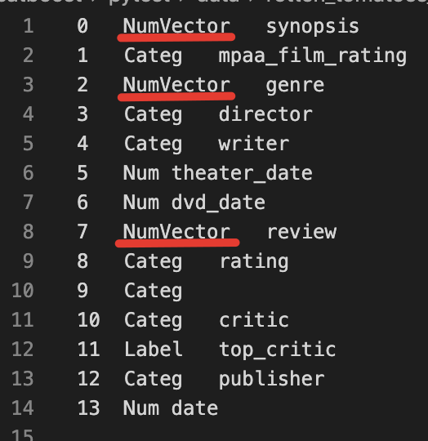
Как попробовать эмбеддинги в CatBoost?
0.00052754587;...;-0.022502214;-0.046597037\t
PG-13\t
0.12662199;0.194815;...;-0.244185;-0.30306\t
Clint Eastwood\t
Richard LaGravenese|Richard La Gravenese\t
19950602\t
19970925\t
-0.08898213;0.20778978;...;0.075812995\t
4/5\t
Fresh\t
Angie Errigo\t
0\t
Empire Magazine\t
20130731
Notes:
And on this slide you can see practically all the code you need to write to start training on embeddings and texts in Python.
Creating Pool object is not necessary action, but if you are planning to tune parameters, it’s better to use Pool object to avoid overhead of copying data form python to c++

Slide 18
Польза от текстовых фичей и эмбеддингов
Accuracy на IMDB датасете, обучение с параметрами по умолчанию
BOW + Online Text Features
0.897
+ Embeddings
0.908
Notes:
We measured quality of training catboost on classical IMDB dataset with and without embeddings – left depicts a result of training catboost on imdb texts only and as you see, CatBoost gives rather good quality even without parameter tuning
And adding bert embeddings help to get another 1 percent point of accuracy also without any tuning.

Slide 19
Датасет со смешанными типами данных
Rotten Tomatoes: movie review
Численные
runtime
box_office – число денег от продажи билетов
Категориальные
critic – имя обозревателя
publisher – журнал, где обзор был опубликован
Тексты
review – текст обзора, написанный критиком
genres – список жанров, которым соответствует фильм
Текстовые эмбеддинги
BERT, GPT, Word2Vec или любые другие эмбеддинги
review
One very long, dark ride.
genres
Action and Adventure | Art House and International | Drama | Mystery and Suspense
Notes:
Now let’s look at mixed dataset with all kind of features, supported by catboost - rotten tomatoes dataset. This dataset is a multiclassification dataset.
This dataset have numerical features, describing measurable properties – film duration, film earnings.
It has categorical values – critic name, publisher name
And it has text columns – film review and a list of genres.
We applied pretrained bert embeddings to text columns to generate two embedding columns.

Slide 20
Польза от текстовых фичей и эмбеддингов
Accuracy on Rotten Tomatoes
Numerical + Caterogical
0.4592
+ BOW
0.4616
+ Online Features
0.4714
Notes:
If we fully ignore all text features, catboost will give you a multiclass accuracy of 0.459. If you’ll add only bag of word text feature estimators, it will improve score just slightly. Adding all online feature estimators again gives around 1 percent point accuracy improvement which is somehow good on this noizy dataset.

Slide 21
Spark и распределенное обучение

Slide 22


Обучение на больших данных
Чтение сырых данных
Квантизация
Обучение
1TB
(tsv данные)
~160GB
бинарное
представление
~160GB
столько нужно памяти при обучении
Notes:
Эмбеддинг,=и используем нескоклько перестановок при подсчете фичей, за счет чего выигрываем по качеству у наивного подхода (невозможно повторить снаружи от CatBoost обучения)
Бывает часто когда рядом с текстом есть некоторое количество фичей, (rotten tomatoes)

Slide 23
Spark
В текущий момент beta версия с ограничениями:
Нет поддержки Windows, GPU, PySpark
Только вещественные фичи и one-hot энкодинг для категориальных
Нет поддержки текстов и эмбеддингов
Приходите, пробуйте, так вы можете помочь нам с развитием Spark обучения!
https://github.com/catboost/catboost/blob/master/catboost/spark/catboost4j-spark/README.md
Notes:
And on this slide we present unique CatBoost features available both in CPU and GPU training
First feature is automatic learning rate estimation mechanism – we look at iterations count and dataset size and automatically adjust learning rate to achieve best quality
Another feature is a set of three different tree building strategies – symmetric trees (I called them oblivious later), lossguide and depthwise tree building
Next feature can be very useful when you have some kind of golden feature. Some features loss a lot information during quantization. For those features you can manually override global quantization settings, and quantize it’s values into 2k buckets, not by default 254

Slide 24
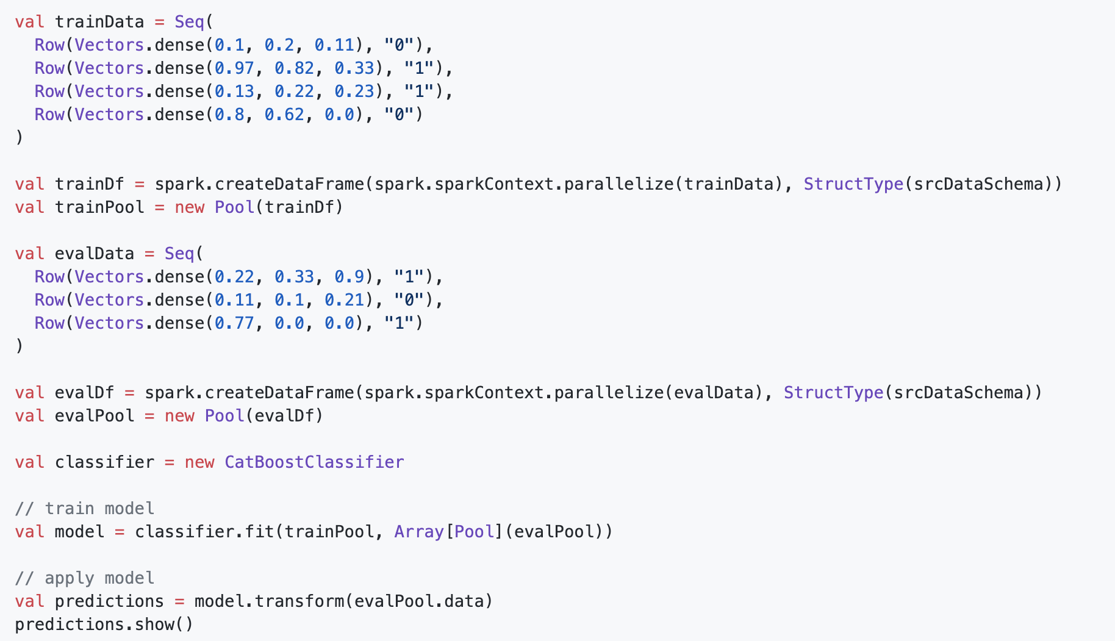
Spark: как запустить обучение
https://github.com/catboost/catboost/blob/master/catboost/spark/catboost4j-spark/README.md
Notes:
And on this slide we present unique CatBoost features available both in CPU and GPU training
First feature is automatic learning rate estimation mechanism – we look at iterations count and dataset size and automatically adjust learning rate to achieve best quality
Another feature is a set of three different tree building strategies – symmetric trees (I called them oblivious later), lossguide and depthwise tree building
Next feature can be very useful when you have some kind of golden feature. Some features loss a lot information during quantization. For those features you can manually override global quantization settings, and quantize it’s values into 2k buckets, not by default 254

Slide 25
Распределенное обучение: один хост, много GPU
CatBoost
GPU 0
Data part 0
Histograms
GPU 1
Data part 1
Histograms
GPU 4
Data part 4
Histograms
GPU 5
Data part 5
Histograms
GPU 2
Data part 2
Histograms
GPU 3
Data part 3
Histograms
GPU 6
Data part 6
Histograms
GPU 7
Data part 7
Histograms
Две разные раскладки данных:
Document parallel – данные распределяются между GPU по рядам
Feature parallel – данные распределяются между GPU по колонкам фич
Notes:
And of course CatBoost can utilize more than single device – by default CatBoost uses all available devices.
We have two different parallelization schemes while training on more than one device – first is document parallel, when all objects are splitted in groups of uniform size and features for each group goes on separate device. This scheme is used when you don’t have counters for categorical features.
When categorical features are present in dataset with more than one-hot-max size unique values, we use feature parallel layout, when features are divided into groups of uniform size and distributed across devices. This allows to calculate categorical feature counters in parallel and to avoid excessive data copying.

Slide 26
Распределенное обучение: редукции гистограмм
CatBoost
III
GPU 0
Data part 0
Histograms
GPU 1
Data part 1
Histograms
GPU 4
Data part 4
Histograms
GPU 5
Data part 5
Histograms
I
I
II
II
GPU 2
Data part 2
Histograms
GPU 3
Data part 3
Histograms
GPU 6
Data part 6
Histograms
GPU 7
Data part 7
Histograms
I
I
Пример: редукции гистограмм с использованием дерева редукций
Если две карты имеют быстрый доступ к памяти друг-друга (например, NVLink) то CatBoost не использует лишние копирования данных
Notes:
Let me show you how document parallel scheme works.
To compute feature split score, we need fully aggregated histogram for that feature from all the devices.
So, initially we are computing all individual features histograms on each device, then we are running one of reduction schemes – we implemented ring reduction and tree reductions.
If histograms are big enough, for example in case of pairwise loss functions, where you build two dimensional hessian matrix, that scheme speeds reduction phase.
On that stage we are using fast peer-to-peer access over nvlink if its available – we don’t copy histograms but read them from peer-devices memory

Slide 27

Распределенное обучение: мульти-хост мульти-GPU
OpenMPI
Host rank 0
Host rank N
CatBoost
CatBoost
GPU 0
Data 0
GPU 1
Data 1
GPU 4
Data 4
GPU 5
Data 5
…
GPU 0
Data N*8 + 0
GPU 1
Data N*8 + 1
GPU 4
Data N*8 + 4
GPU 5
Data N*8 + 5
GPU 2
Data 2
GPU 3
Data 3
GPU 6
Data 6
GPU 7
Data 7
GPU 2
Data N*8 + 2
GPU 3
Data N*8 + 3
GPU 6
Data N*8 + 6
GPU 7
Data N*8 + 7
Notes:
This scheme expands to multi-host training with help of OpenMPI library.
You should define a single MPI run-slot per machine and then start training. Only document parallel layout is currently supported for such training, so this scheme didn’t support complex cat feature counters calculation.

Slide 28
Распределенное обучение: мульти-хост мульти-GPU
CatBoost использует MPI для передачи данных и команд.
Запустить очень просто:
mpirun -np $HOSTS_COUNT -bind-to none -map-by slot /path/to/catboost fit --learn-set quantized://path_to_quantized_train --loss-function Logloss
Ограничение: сейчас CatBoost читает все данные в процессе с глобальным ранком 0.
Notes:
Also this scheme has one major limitation – currently, all the data Is read and distributed to other hosts via process on host with zero rank
A command that start training is rather simple, but don’t forget to disable process binding to cpu slot or thread, as it could affect training speed

Slide 29

Предсказание неопределенности

Slide 30
Зачем предсказывать неопределенность?
Медицина
Предсказания спроса
Финансы и кредиты
Промышленность
Notes:
Also this scheme has one major limitation – currently, all the data Is read and distributed to other hosts via process on host with zero rank
A command that start training is rather simple, but don’t forget to disable process binding to cpu slot or thread, as it could affect training speed

Slide 31
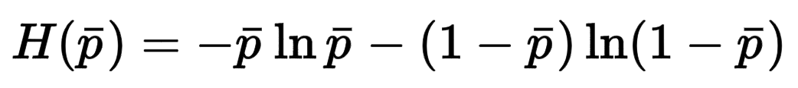
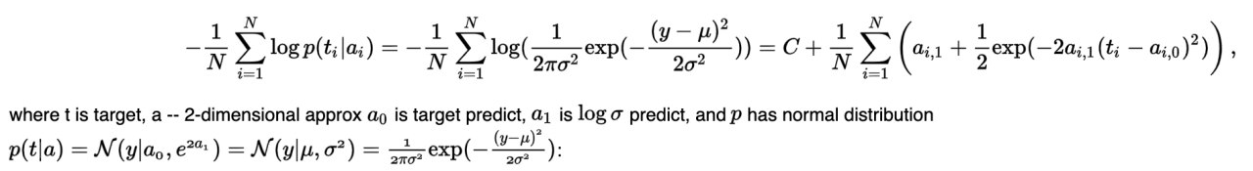
Неопределенность в данных
Для классификации – энтропия предсказания
Для регрессии – можно оценить при помощи подхода Natural Gradient Boosting (NGBoost)
В CatBoost этот лосс называется RMSEWithUncertainty
Notes:
Also this scheme has one major limitation – currently, all the data Is read and distributed to other hosts via process on host with zero rank
A command that start training is rather simple, but don’t forget to disable process binding to cpu slot or thread, as it could affect training speed

Slide 32
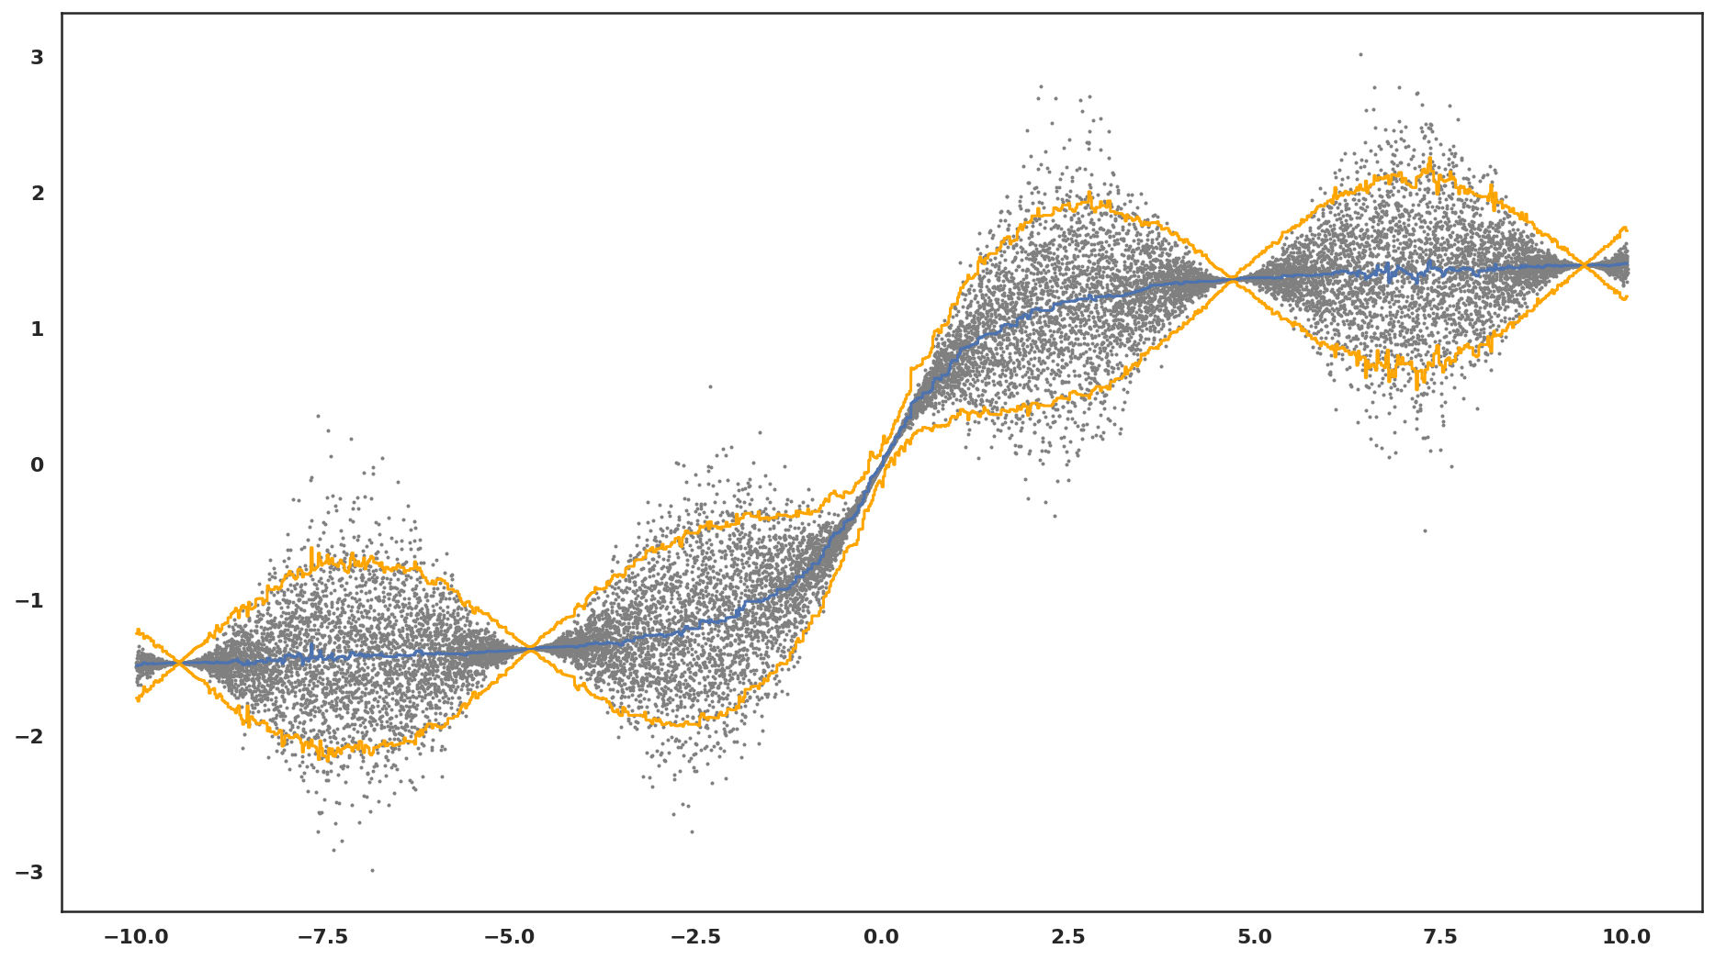
Неопределенность в данных
Notes:
Also this scheme has one major limitation – currently, all the data Is read and distributed to other hosts via process on host with zero rank
A command that start training is rather simple, but don’t forget to disable process binding to cpu slot or thread, as it could affect training speed

Slide 33
Неопределенность в знаниях: ансамбли
+
+
+
…
Регрессия
Дисперсия предсказаний – неопределенность знания
Классификация
Средняя энтропия - полная неопределенность
Энтропия среднего – неопределенность данных
Модель 1
+
+
+
…
Модель 2
…
+
+
+
…
Модель N
Notes:
Also this scheme has one major limitation – currently, all the data Is read and distributed to other hosts via process on host with zero rank
A command that start training is rather simple, but don’t forget to disable process binding to cpu slot or thread, as it could affect training speed

Slide 34
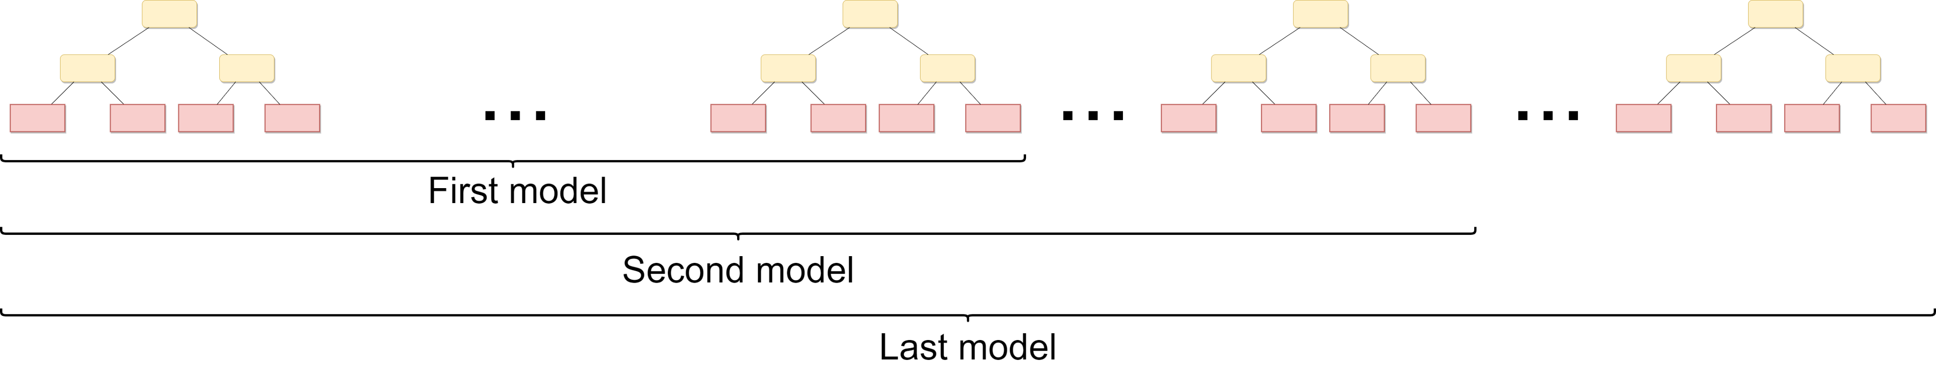
Неопределенность в знаниях: виртуальные ансамбли
Notes:
Also this scheme has one major limitation – currently, all the data Is read and distributed to other hosts via process on host with zero rank
A command that start training is rather simple, but don’t forget to disable process binding to cpu slot or thread, as it could affect training speed

Slide 35
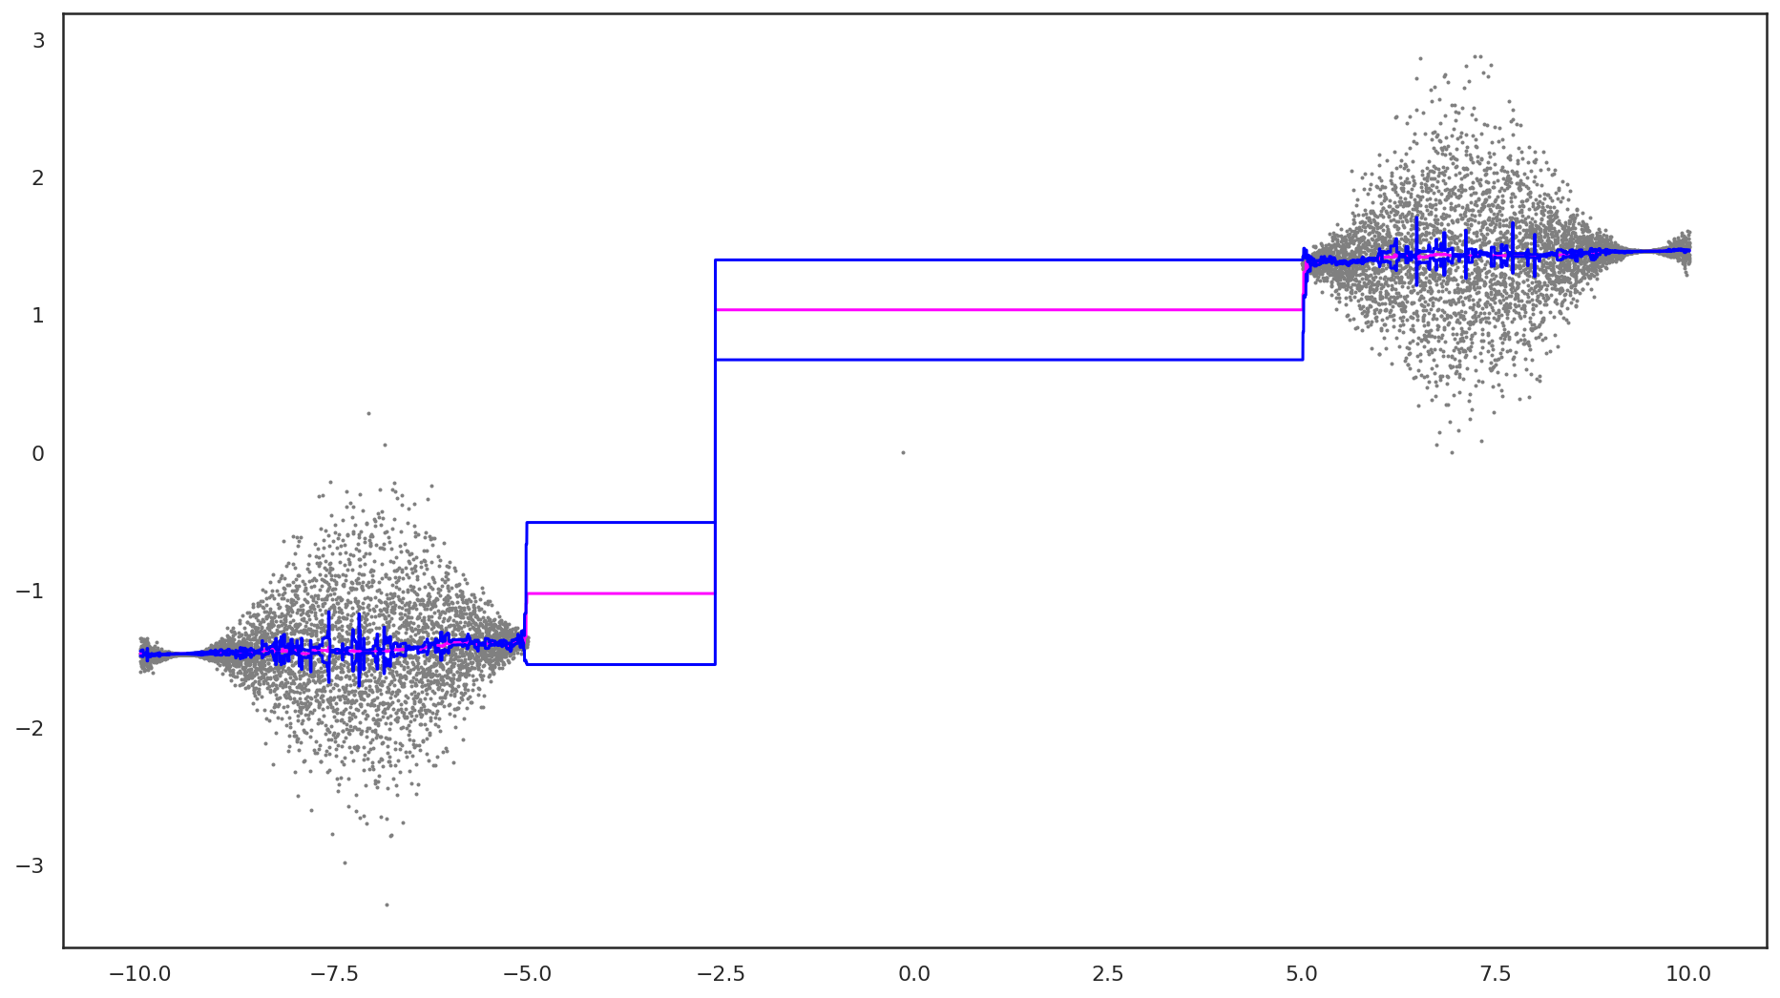
Неопределенность в знаниях
Notes:
Also this scheme has one major limitation – currently, all the data Is read and distributed to other hosts via process on host with zero rank
A command that start training is rather simple, but don’t forget to disable process binding to cpu slot or thread, as it could affect training speed

Slide 36
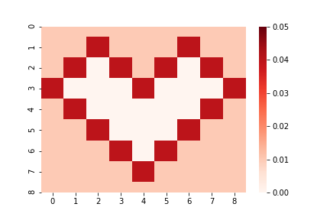
Неопределеность: еще один пример
Исходные данные
Notes:
Also this scheme has one major limitation – currently, all the data Is read and distributed to other hosts via process on host with zero rank
A command that start training is rather simple, but don’t forget to disable process binding to cpu slot or thread, as it could affect training speed

Slide 37
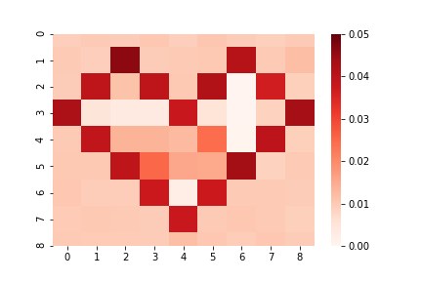
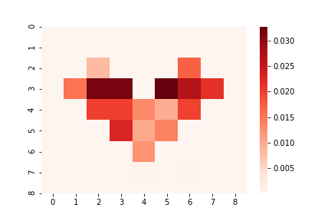
Неопределеность: еще один пример
Предсказанние неопределенности данных
Предсказанние неопределенности знаний
Notes:
Also this scheme has one major limitation – currently, all the data Is read and distributed to other hosts via process on host with zero rank
A command that start training is rather simple, but don’t forget to disable process binding to cpu slot or thread, as it could affect training speed

Slide 38
Новости и планы

Slide 39
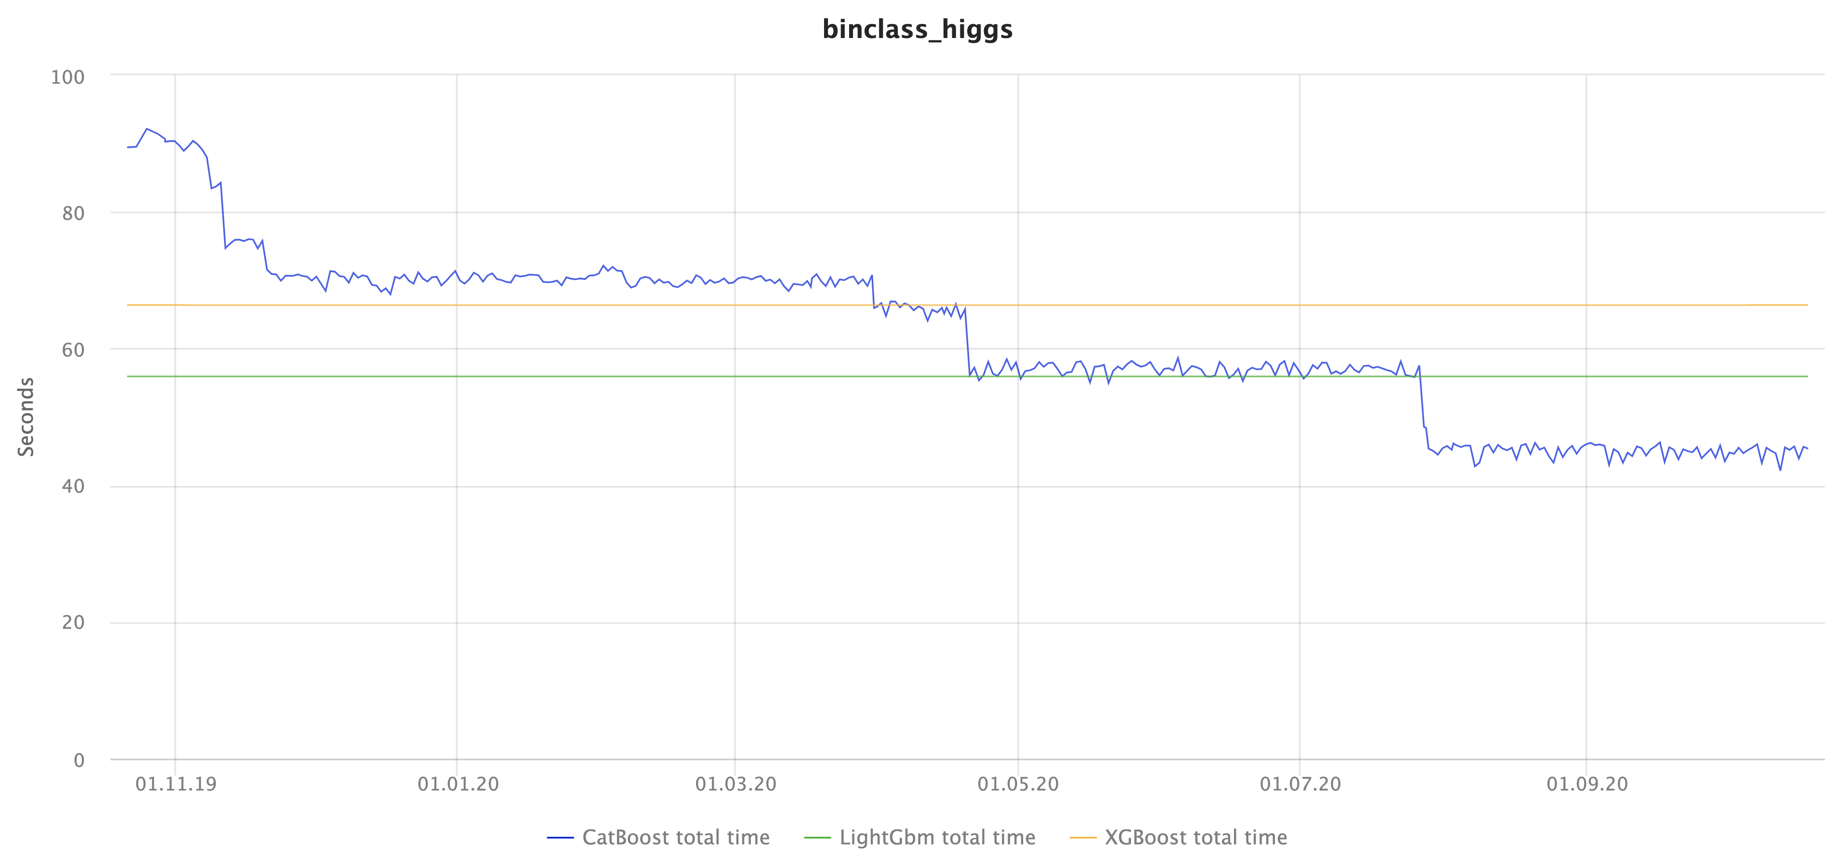
Cкорость
Notes:
Also this scheme has one major limitation – currently, all the data Is read and distributed to other hosts via process on host with zero rank
A command that start training is rather simple, but don’t forget to disable process binding to cpu slot or thread, as it could affect training speed

Slide 40
Новые функции
posterior_sampling – включает бустинг с динамикой Ланжевана, выставляет правильные параметры для возможности оценки неопределенности через виртуальные ансамбли
auto_class_weights – автоматически выставляются веса для классов, может быть полезно для несбалансированных датасетов
first_feature_use_penalties – штрафы за первое использование фичей
feature_weights – веса фичей, применяются к скорам по сплитам этих фичей
PRAUC metric
Notes:
Also this scheme has one major limitation – currently, all the data Is read and distributed to other hosts via process on host with zero rank
A command that start training is rather simple, but don’t forget to disable process binding to cpu slot or thread, as it could affect training speed

Slide 41
Новые функции GPU обучения
Golden features – поддержали квантизацию на больше чем 254 границы
Поддержали MVS сэмплирование на GPU и включили его по умолчанию
Поддержали штраф за размер модели model_size_reg – модели со счетчиками по категориальным фичам стали в разы меньше (штрафуем сложные комбинации фичей, в модель попадают только самые полезные)
Сократили потребление памяти при распределенном обучении на огромных датасетах (терабайты данных)
Notes:
Also this scheme has one major limitation – currently, all the data Is read and distributed to other hosts via process on host with zero rank
A command that start training is rather simple, but don’t forget to disable process binding to cpu slot or thread, as it could affect training speed

Slide 42
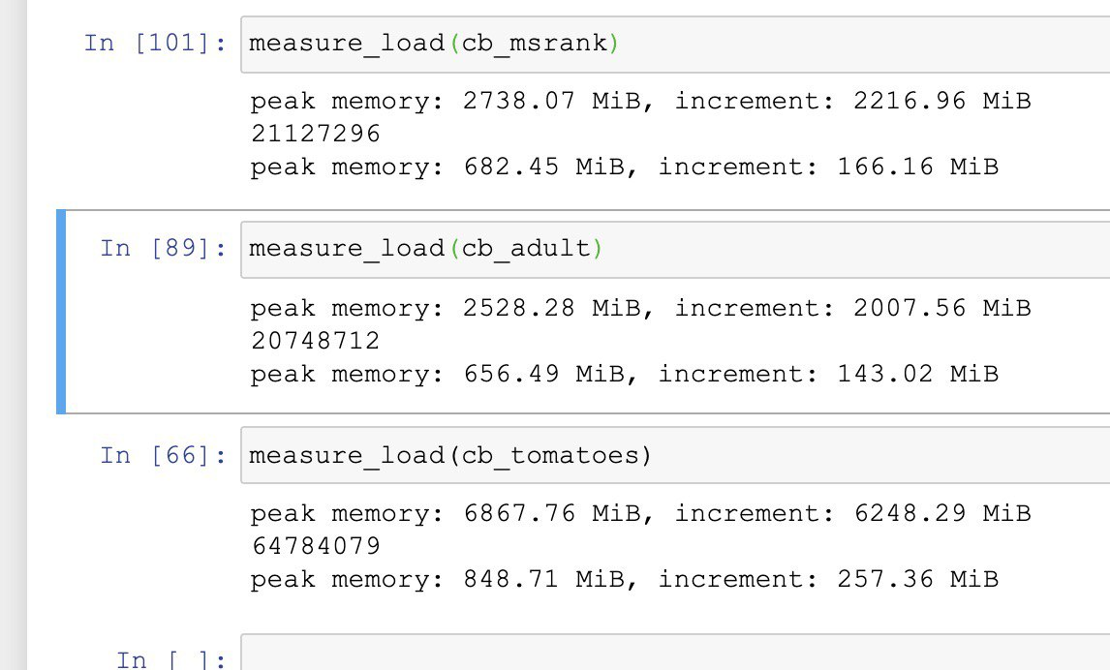
”Zero-cost” десериализация модели в Python
Если у вас есть бинарная строка с моделью CatBoost, например, полученная из S3 или откуда-то еще, то мы сделали новый режим загрузки из бинарного блоба:
model = CatBoost()
model.load_model(blob=b’…’)
Notes:
Also this scheme has one major limitation – currently, all the data Is read and distributed to other hosts via process on host with zero rank
A command that start training is rather simple, but don’t forget to disable process binding to cpu slot or thread, as it could affect training speed

Slide 43
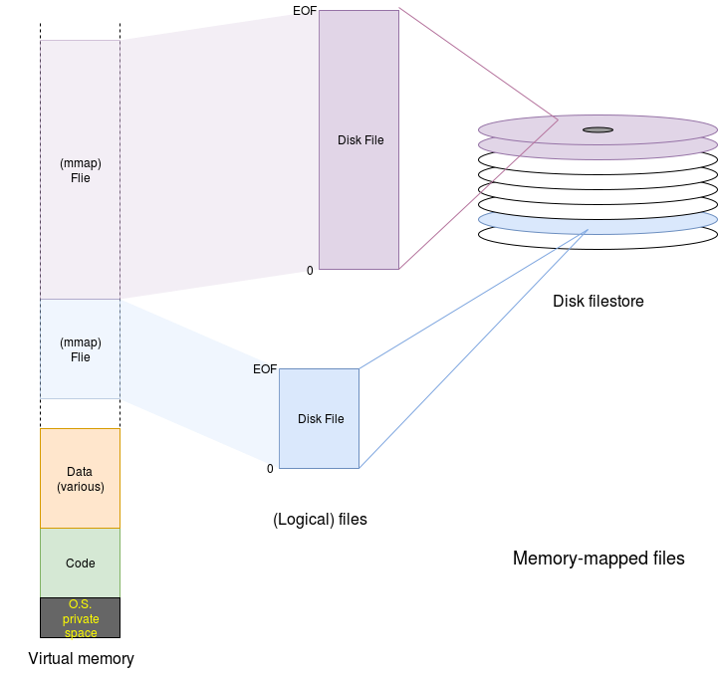

”Zero-cost” десериализация модели
Notes:
Also this scheme has one major limitation – currently, all the data Is read and distributed to other hosts via process on host with zero rank
A command that start training is rather simple, but don’t forget to disable process binding to cpu slot or thread, as it could affect training speed

Slide 44
Планы
Продолжаем бороться за скорость и стабильность
Развиваем Spark: Windows, GPU, конфигурируемые счетчики
Поддержка R библиотеки: CRAN, паритет по фичам с Python
Новые режимы: рекурсивный отбор фичей
Эксперименты с новыми моделями и режимами
Notes:
Also this scheme has one major limitation – currently, all the data Is read and distributed to other hosts via process on host with zero rank
A command that start training is rather simple, but don’t forget to disable process binding to cpu slot or thread, as it could affect training speed

Slide 45
Вопросы?
catboost.ai
github.com/catboost
twitter.com/CatBoostML
t.me/catboost_en, t.me/catboost_ru
ods.ai => slack => tool_catboost chanel
Кириллов Станислав,
Руководитель группы ML систем @ Яндекс
Notes:
Thank you for attention! Feel free to ask our team about anything in our official telegram chat and report any bugs and invonviniences to github issues.
Good luck to you and your beloved ones! Stay safe and healthy.

